Slide 1
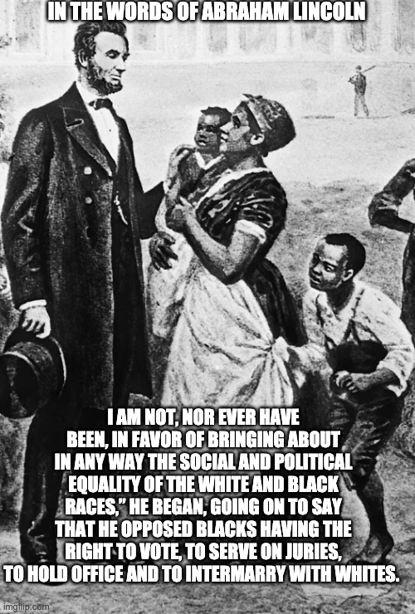
Responsible Media Consumption, Part 3
Hello again!
This is the video for Week 4 of classes (Week 4 =
Thursday, Sept. 22nd, to Wednesday, Sept. 28th). You
have until 11:59 PM on Friday, Sept. 30th, to finish
watching this lecture (required for everyone) and finish
Assignment #2 at the end. If you choose to do
Assignment #2, you can bring it to me in class on the
30th or email it to anparoikos@gmail.com.
We are going to learn about more logical fallacies and
other ways in which people view the past erroneously (or
not? Opinions differ).
This presentation copyright 2022– Nelson Parish
Lincoln: https://imgflip.com/i/45w4d7?nerp=1592804809

Slide 2
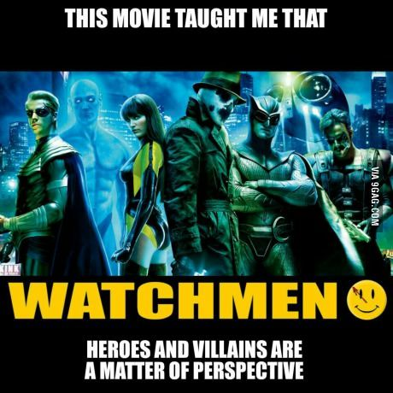
“Would have…”
Let’s start with something that is not really a fallacy, but you hear it in arguments all the time. “If A would(n’t) have happened, then B would(n’t) have happened.”
This might be an OK argument for simple, predictable events. “If you hadn’t dropped that glass, it wouldn’t have broken.” We’ve experienced
or seen dropped glasses breaking enough that we know
this is probably true, at least assuming our
understanding of physics is correct and the elves that
control gravity didn’t decide to make the glass fly
instead of drop.
When we get into more complicated systems involving
people, societies, weather, animals, etc., “would have”
arguments are almost useless unless, perhaps, you’re
trying to think up a movie about an alternate timeline,
engaging in a thought experiment, or giving advice to a
friend who made a mistake.
This presentation copyright 2022– Nelson Parish
Watchmen: https://www.pinterest.co.kr/pin/514254851175470293/?nic_v3=1a5T2NWFH

Slide 3
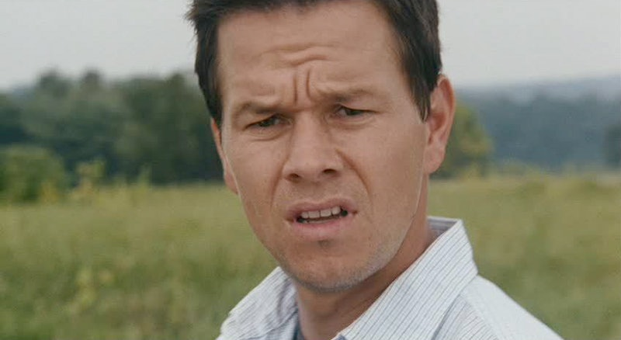
The Real and Unreal Past
Regarding giving advice to friends. Imagine a scenario in which a student, C, is offended by a professor in class and starts crying. Their best friend, D, might tell them later, “I wouldn’t have cried! I would have demanded an apology!” Maybe it’s true that D is the type of person that would do this, and maybe they had actually done it before in a similar situation. However, it’s impossible to prove that D would have, in that particular situation that made C cry, demanded an apology. We might think it’s likely, but every situation is different, no matter how similar. If D were tired or had just gotten a nice gift from a lover or realized they needed the professor’s recommendation later or something like that, they might not have demanded an apology. In fact, with D being there instead of C (or with C), the situation is significantly different from what C experienced alone.
Actor Mark Wahlberg got into trouble about
10 years ago when he said that if he had been
on one of the hijacked planes on 9/11, he would
have beaten up the terrorists and landed the
plane safely. Not only was this incredibly
offensive to those who lost their lives and their
families and Americans in general, but it was a
moot point. He wasn’t there. Had he been there,
it might have changed the situation in an
unpredictable way (“Hey, one of the passengers
is Mark Wahlberg, the famous movie star who
beats up bad guys onscreen. I bet he’s tough.
Before we start, let’s kill him first to make sure
he doesn’t stop us.”). We’ll never know because
it’s not part of our reality.
This presentation copyright 2022– Nelson Parish
Wahlberg: https://www.bustle.com/articles/29640-mark-wahlbergs-perpetually-confused-face-vs-other-famous-furrowed-brows-who-wins

Slide 4
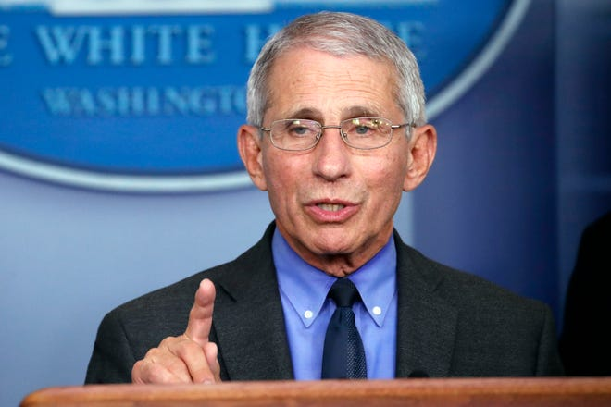
Future “Would”
Of course, this “would” or “will” applies to future events as well. We might think we know what we would do if, for example, there are a fire in our apartment or if someone collapsed in front of us on the street or if we won $1 million in the lottery. However, even people who have run into this situation before or even often can never be sure of exactly what they’d do. Even if we risked our life to warn all of our apartment neighbors in a past fire, that doesn’t mean we’d do it again in a similar but different situation. Perhaps the next fire will be hotter. Perhaps we’ll be injured. Perhaps we now have a family we’d rather protect at the expense of our neighbors.
This goes to media consumption as well, and I talked about it in the previous pre-recorded lesson. My economics students will get tired of me saying it this semester, but true experts don’t say “will” when they’re talking about complex systems like
weather, economies, war and peace, etc. They know that
they don’t have enough knowledge to be correct. They’ll
use words and expressions like “might,” “is likely,”
“Things could change,” etc. This drives viewers crazy
because they want clarity and certainty, but it’s the most
honest way for an expert to speak. “Fools think they know
it all, but wise people know they (themselves) don’t.”
This presentation copyright 2022– Nelson Parish
Fauci: https://www.detroitnews.com/story/sports/nfl/lions/2020/05/11/dr-anthony-fauci-virus-response-determine-nfl-season/3108482001/

Slide 5
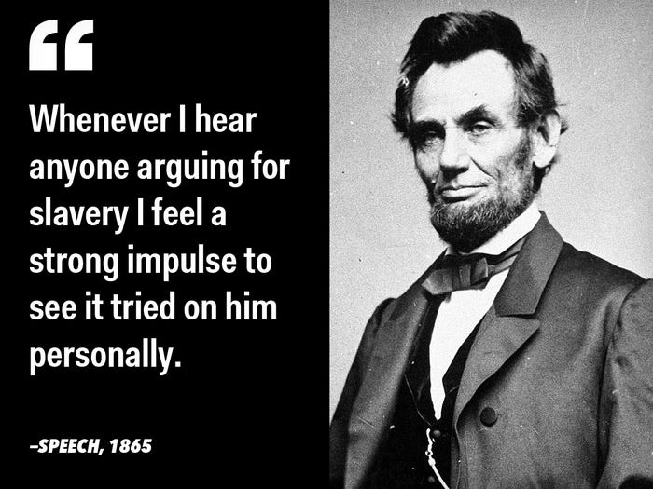
What the heck does this have to do with Abe Lincoln and Robin Hood?
In class on the 23rd, we did an activity about ethics and morals in the time of Robin Hood. No one knows exactly who he was or if he even truly existed. Some say he’s an amalgam of different people in the 13th and 14th Centuries. It’s likely the answer you chose in the activity reflects modern values of how women are viewed in the various countries we’re from. There are few countries now that restrict women’s rights at the same level as in England 700 or 800 years ago. English society in Robin Hood’s time simply had different ethics, and most people had very different morals from what we have today, even “good guys” like Robin Hood. It’s very likely that many people would have said that Marion
did a horrible thing by sleeping with the Sheriff to save Robin Hood.
What about Abe Lincoln? He would have been appalled at seeing
Barack Obama elected president of the US in 2008. Of course, we’re
talking about a fake universe in which Lincoln is still alive either
because he’s a) been transported here via a time machine, or b) is
over 200 years old and has not changed his opinions at all for his
entire life. He’d be considered a despicable person by the vast
majority of Americans today instead of being seen as one of our
greatest presidents.
This presentation copyright 2022– Nelson Parish
Lincoln: https://thefederalistpapers.org/us/boom-hilarious-meme-reveals-obamas-greatest-fear

Slide 6
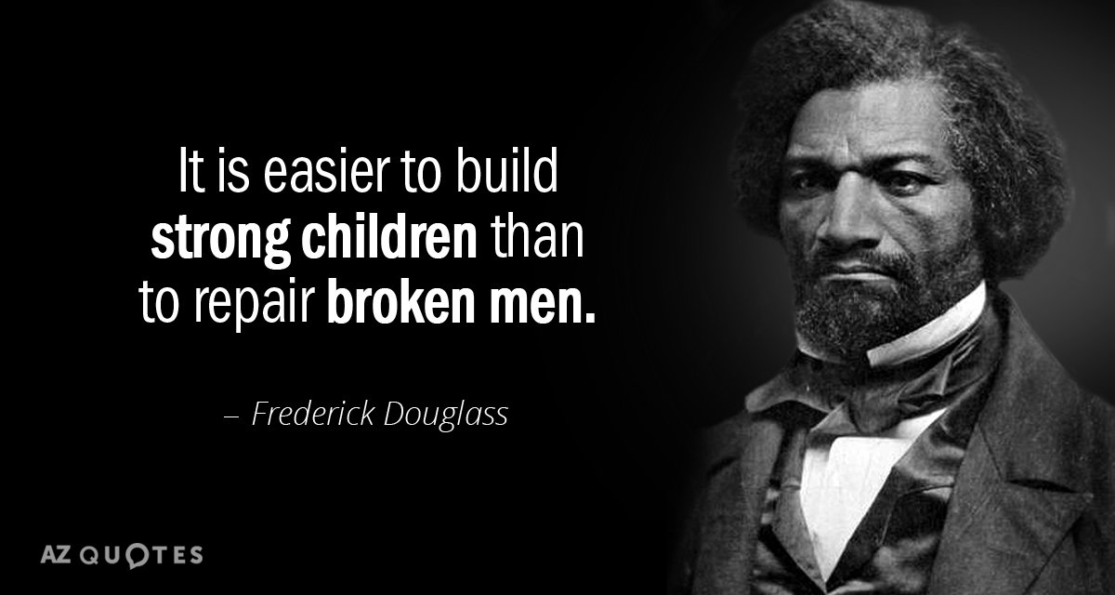
What would you have done?
You often hear people say things like, “If I had lived in the American south in the mid-19th Century, I wouldn’t have been racist. I would have tried to free the slaves.” Good for you! Hard to believe, but it’s possible.
First of all, you’re assuming “ceteris paribus,” or “everything else remains the same.” If you had grown up in the American south in the mid-1800s, that would probably not be the case. You would be a very different person from what you are now, and you would hold very different values. You’d know nothing of germs or bacteria, you wouldn’t be able to vote if you were a woman, and you would most likely be quite poor. You wouldn’t be the person you are now.
But wait! What if you were magically transported back to the American south right now, complete with your values and morals? Would you lead the fight against slavery using your 21st-Century morals? Good luck. There’s a good chance you’d be killed, actually, Quite a few very brave people of all races did just that, and many of them were killed by their own neighbors (lynching). In fact, in some areas of the US (and in the British colonies beforehand), it was
illegal to free one’s slaves or fight for abolition. If you weren’t killed
by those you lived with, it possible you would have been jailed or
executed.
Isn’t Mr. Parish talking about “What would have happened”? Yes, I
am, and you’re right that there’s no way I can be sure of what would
have happened in a complex situation that didn’t occur. I can say,
based on the historical record, though, what would be a very likely
outcome. Notice I’m not using terms like “would have.”
This presentation copyright 2022– Nelson Parish
Douglass: https://www.azquotes.com/quote/81100

Slide 7
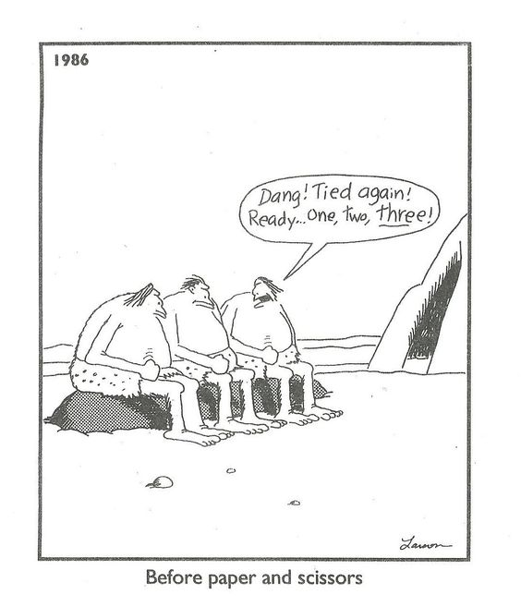
Fallacies That Can Be Caused by “Would Have”
“Would have” arguments can lead to fallacies that prevent us from understanding the past. These include:
1) Historian’s Fallacy - This is assuming that people from the past had the same perspective of a situation and the same knowledge about it that we do.
2) Presentism – This projects present-day ideas and morals into situations or onto people from the past.
3) Chronological Snobbery – This happens when we think lesser of
people from the past (They were dumber, etc.) because they did not
know or have the ideas and technology that we have now.
4) Vacuous Truth – Related to Historian’s Fallacy, this is not only for
past situations, but it’s often found when people are talking about the
past. Basically, it’s stating something that is true, but it’s true because
there is no way that the alternative could be true.
Let’s look at examples of each of these and find out why using these
fallacies hurts dead people’s feelings and/or cause us to misunderstand
the past and make us less able to learn from history.
This presentation copyright 2022– Nelson Parish
Cavemen: https://www.pinterest.com.mx/pin/327777679100388817/?nic_v3=1a5T2NWFH

Slide 8
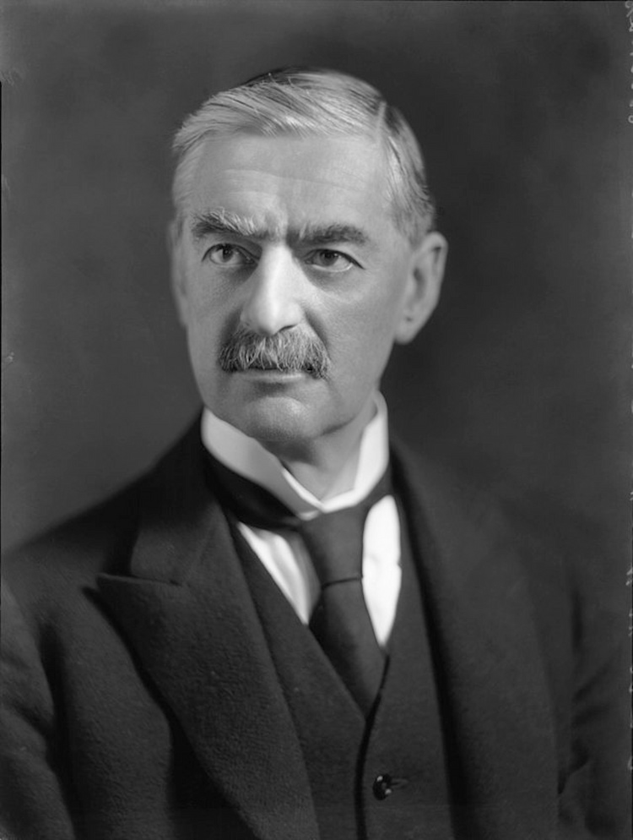
Historian’s Fallacy
Why did British Prime Minister Neville Chamberlain appease Hitler by signing the Munich Agreement in 1938? This allowed Hitler to take part of Czechoslovakia by force. Didn’t Chamberlain know that Hitler, despite his promises, wouldn’t stop at taking just a little bit of that country? Didn’t he know it would inspire Hitler to try to take even more land in Poland, Austria, etc.?
“If Chamberlain hadn’t appeased Hitler, World War II would
not have happened.”
Do you agree? If Hitler hadn’t been appeased, do you think he
would have just stuck in Germany and not tried to take over
other countries? We’ll never know for sure, of course.
What might Chamberlain not have known when he appeased
Hitler? What might he have known that others at the time (or
many now) didn’t (don’t) know?
This presentation copyright 2022– Nelson Parish
Chamberlain: https://www.historyhit.com/facts-about-neville-chamberlain/

Slide 9
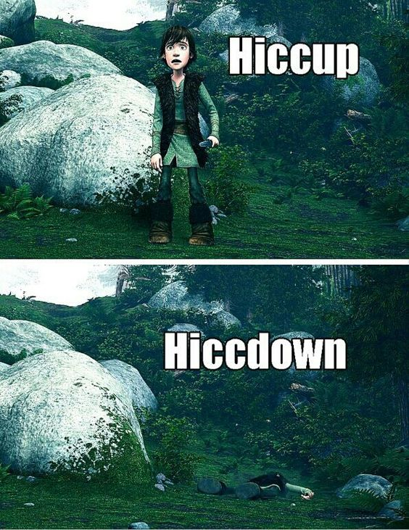
Presentism
Presentism is fun! It allows us to take modern-day values and ideas and put them into the lives of people from past times. Many famous and fun movies are based on Presentism. They’re fun to watch, often because the people in the movies are dealing with new ideas, and that’s always fun.
It causes us, however, to misunderstand how people in the past lived, even fictional people.
Have you seen “How to Train Your Dragon”? It’s a story of a boy named Hiccup, the
son of a Viking chieftain, who befriends one of his clan’s mortal enemies – a dragon!
The boy and the dragon become friends, and the clan is angry with him at first, but
then they realize that it’s good to be friends with those who are different, and diversity
matters, and sometimes people who are very different can team up to do amazing
things. All of these are modern values pervasive in many countries today.
In real life, the chieftain’s son probably would have been killed immediately by his
own father (who would probably have had 16 other sons) for endangering the whole
society. Had the chief not done it, others would probably do it for him and have him
removed as well. Viking life was hard enough without the dangers associated with
befriending enemies. One boy’s mistake could have brought the whole society down.
People lived much closer to the edge back then and had to be very cautious and
conservative.
My wife often complains that I point out stuff like this when we watch movies.
This presentation copyright 2022– Nelson Parish
Hiccup: https://www.pinterest.co.uk/pin/392516923760123056/?nic_v3=1a5T2NWFH

Slide 10
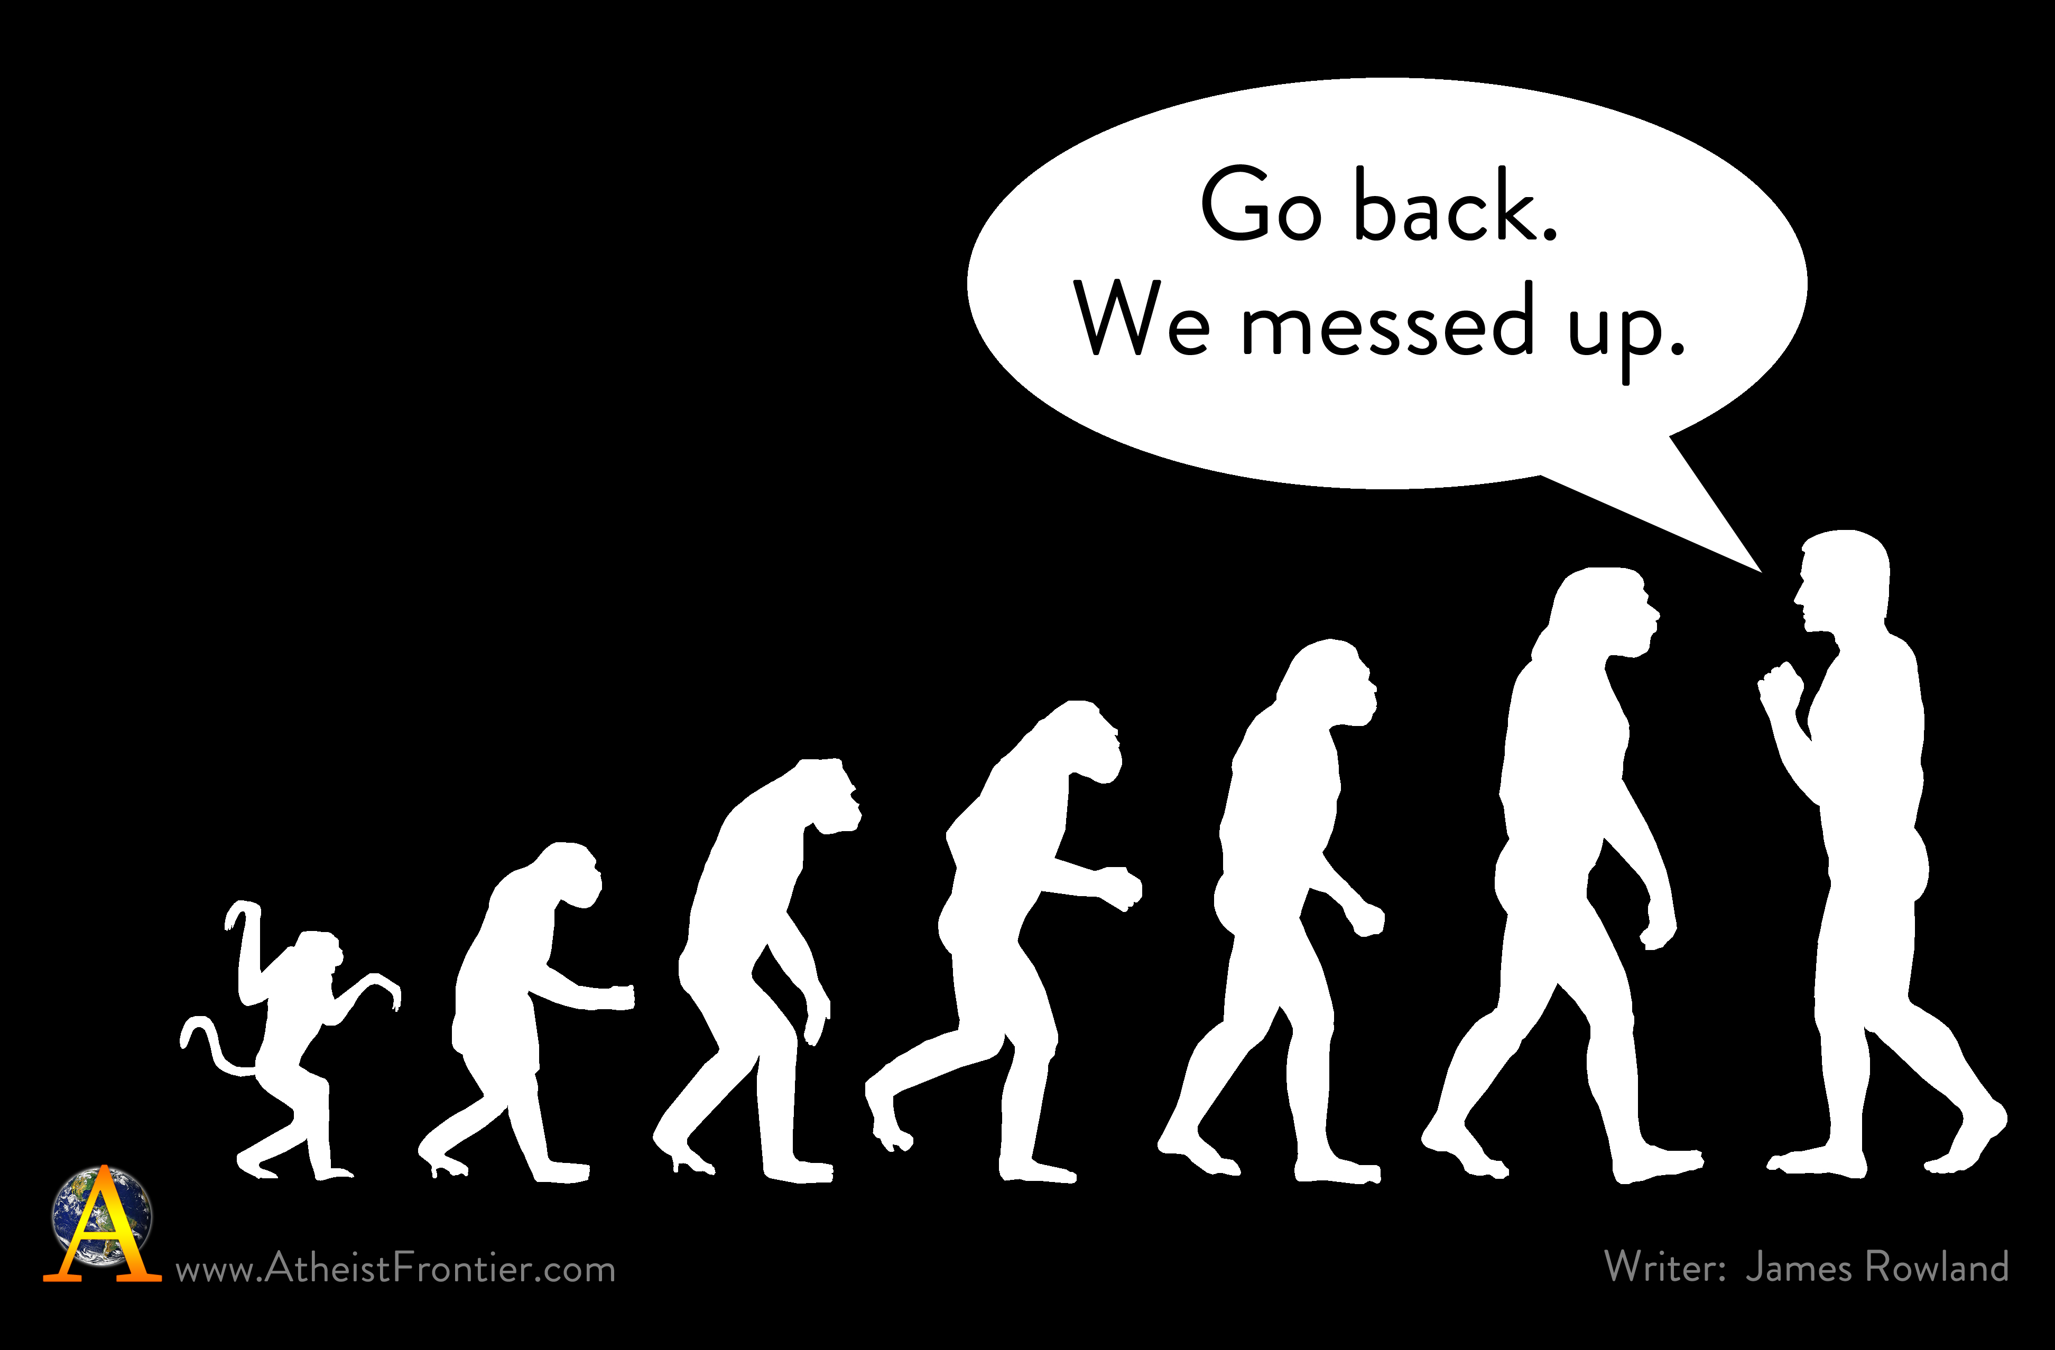
Chronological Snobbery
Chronological Snobbery is a lot of fun, too. There are few things that are funnier than caveman jokes, for example. We like to make fun of how past people dressed, what they ate, what they didn’t know about the world or technology, and so on. We marvel at how stupid people could have been in thinking witches caused disease or misfortune and thus hanged many women (mostly), men, children, and even a couple of dogs, in Salem, Massachusetts, in the 1690s.
Just as people in the past didn’t know what we know now, we don’t know as much as people in the future will assuming, er, things continue to progress (Oh! The Fallacy of Progress = Things continue to get better in general.) – nothing in the future is assured. The values of the past that were considered enlightened (“Blacks should be free, but they shouldn’t be able to vote.”) are considered reprehensible now. However, perhaps you should get ready to hear your grandchildren ask, “Did you really used to eat animals that were raised and slaughtered for their meat?”
When we look down at past people who didn’t have the advantages
(and, in some cases, the disadvantages) that we have, we’re doing
them a disservice and blocking our ability to understand what we’ve
been given by our ancestors and how and why.
We are all people of our time and place. We know what is available
for us to know, and that has been built for us by the people who came
before us, and it is fragile. Thank them despite all of their faults. Er,
also, you can blame them for the bad things we have if you want to
(not that they necessarily knew any better).
This presentation copyright 2022– Nelson Parish
Evolution: https://www.atheistfrontier.com/library/funny/evolution-joke.png

Slide 11

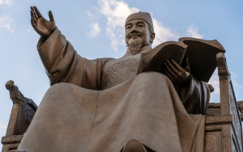
Vacuous Truth
We’ve seen this fallacy before. Vacuous truths can also be fun. They’re used in jokes to make fun of people in the past or even the present. They’re technically true, but they refer to situations that do (did) not exist or are very improbable.
In all the times I’ve stolen a car, I’ve never been arrested. How many times have I stolen a car? Zero. It’s vacuous because it’s true, but it means nothing because (uh, in a perfect world), I’d never be arrested for stealing a car if I hadn’t done it.
I recently heard one person use this argument in arguing against mask mandates in the US: “You never see a picture of Jesus wearing a mask, so why should we have to wear one?”
There are so many problems with this, one of which being masks were not seen as a way of preventing disease in Jesus’s time. Also, there are no pictures of Jesus painted when he was alive. If there were, they would probably not have had him wearing a mask even if his society believed in masks preventing
diseases. It’s a truth that really doesn’t prove anything.
Did you know that King Sejong the Great, as wise as he was, couldn’t even
figure out how to use a cellphone?
This presentation copyright 2022– Nelson Parish
Sejong: https://www.theseoulguide.com/statues_king_sejong_seoul_korea/
Phone: https://freepngimg.com/no-png-result

Slide 12
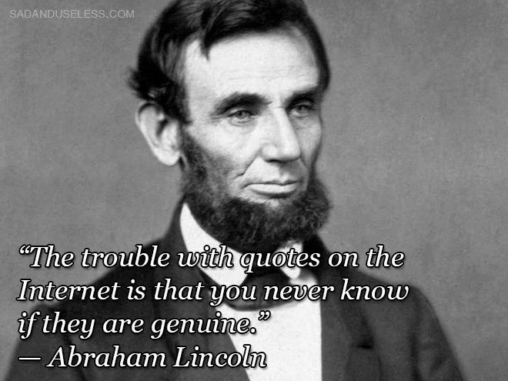
Assignment #2
Here are the questions for this pre-recorded lecture. Please refer to the homework instructions (“Homework Rules PPT” message) I put on E-Class in the “Lecture Resources” section for more information on what I require for homework assignments. Remember, if you do any online research, tell me the webpage (not website – webpage) you got your information from!
1) A government disease expert gives an interview and says, “At this time, we think the virus will probably disappear in six months.” Why is this a good way to give information to citizens? How can it cause misunderstandings?
2) Another fallacy related to the past is the Hindsight Fallacy. We say, “Hindsight is always 20/20.” This fallacy happens when we think that past events were predestined to happen because we now know that they happened (“Of course the Japanese were going to attack Pearl Harbor! It was so obvious!”). How can the Hindsight Fallacy help cause the Historian’s Fallacy?
3) Think of a movie, book, etc., set in the past that displays Chronological Snobbery. What does it do to show how bad, stupid, etc., people in the past were?
4) Think of a movie, book, etc., set in the past that displays Presentism. How is it
“Presentist”?
5) Your opinion: Almost every historical figure did both good and bad things.
Our heroes are remembered for their good, and our villains are remembered for
their bad. Choose a dead hero from your country’s past. What good things are
they known for? What bad things did they do? Do you think they deserve to be
considered a hero? Why or why not?
Reminder: If you choose to do this assignment, you can give it to me at the
beginning of class on Friday, Sept. 30th, or you can email it to
anparoikos@gmail.com by 11:59 on the same day.
Questions? Please let me know!
This presentation copyright 2022 – Nelson Parish
Lincoln again: https://www.sadanduseless.com/less-known-quotes-list/

